Slide 1
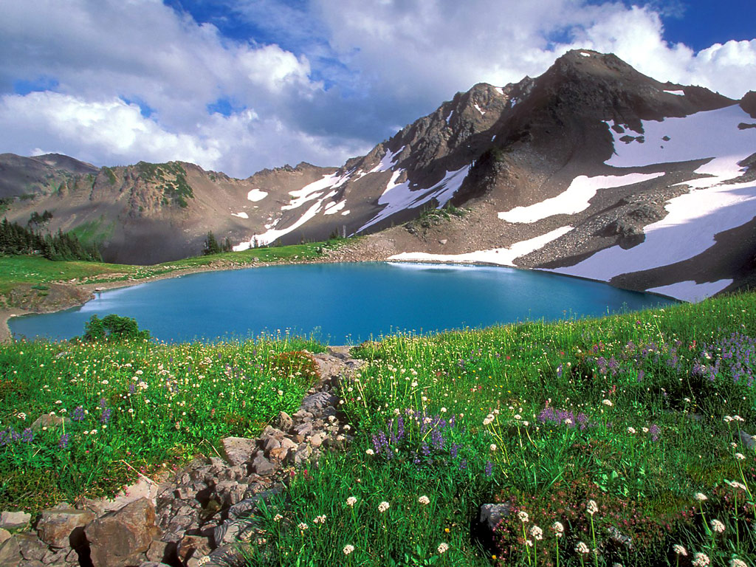

OLYMPIC NATIONAL PARK

Slide 2
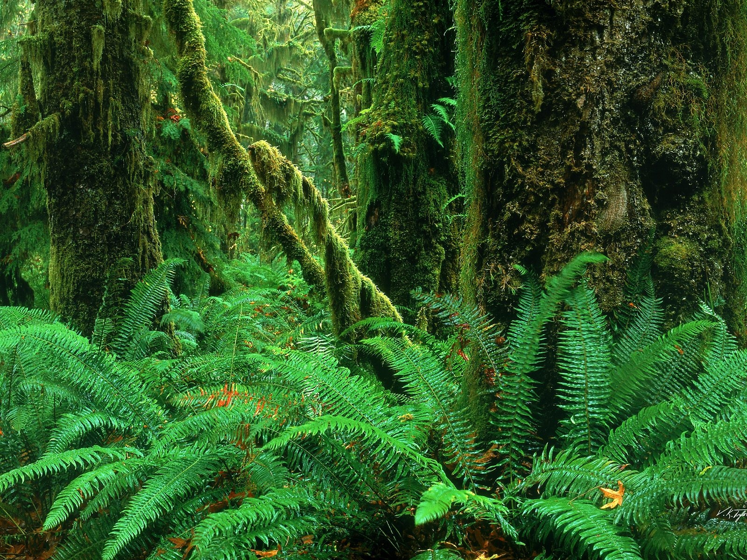
Flora

Slide 3
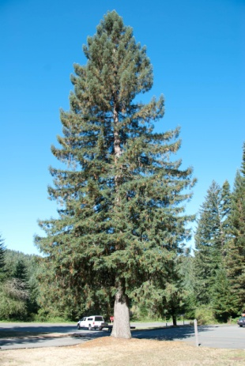
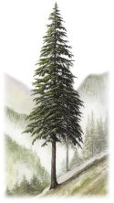
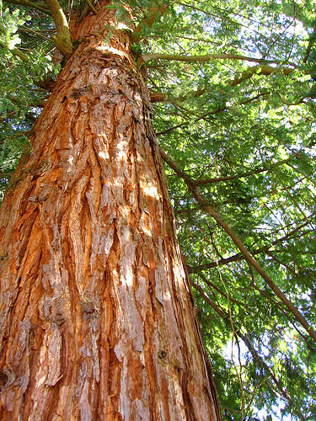
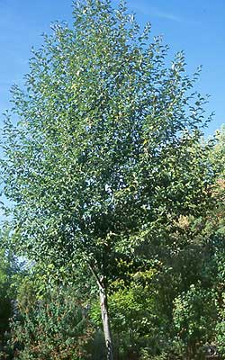
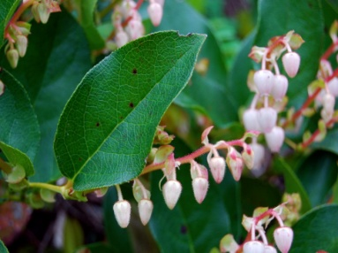
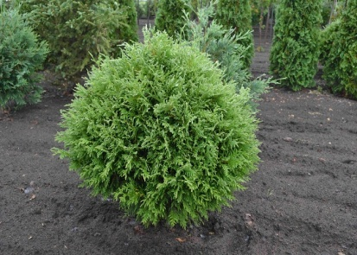
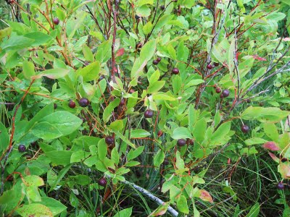
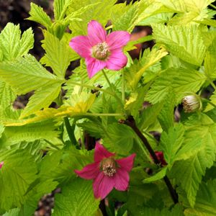
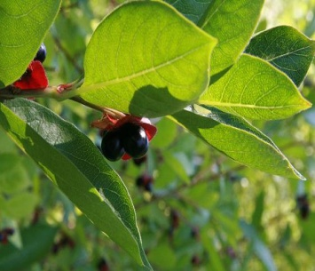
Coastal Forest: (Mild temperatures and abundant rain)
Common Tree Species:
Common Shrubs
Western hemlock
Western red cedar
Red alder
Sitka spruce
Salal
evergreen
huckleberry
salmonberry
Black twinberry

Slide 4
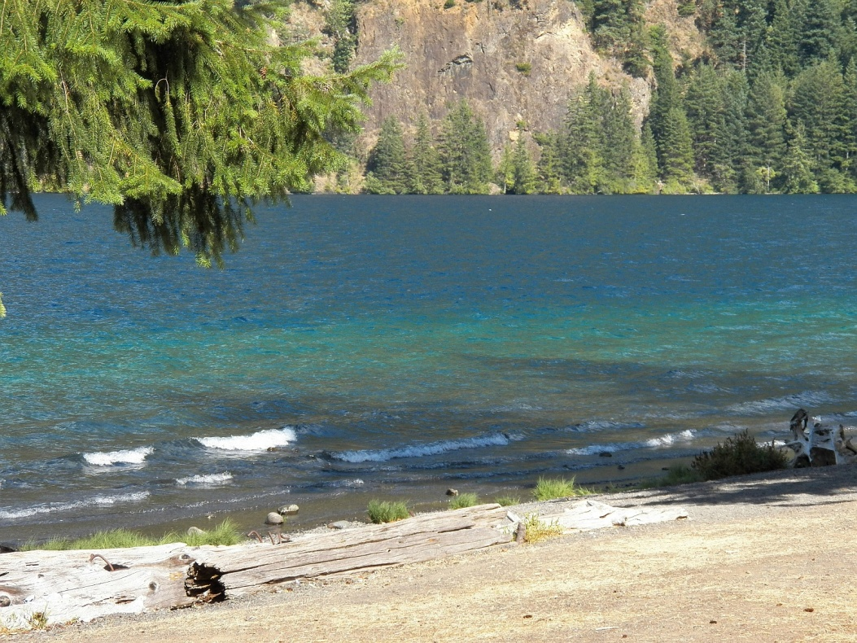
Lowland
Mild climate, deeper soils and generous rainfall grow world record trees
Characteristics can be
Trees older than about 200 years
Abundant downed wood on the ground
A multi-layered canopy
Standing dead trees called snags

Slide 5
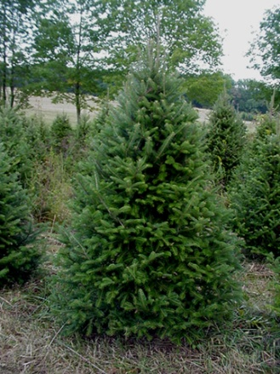
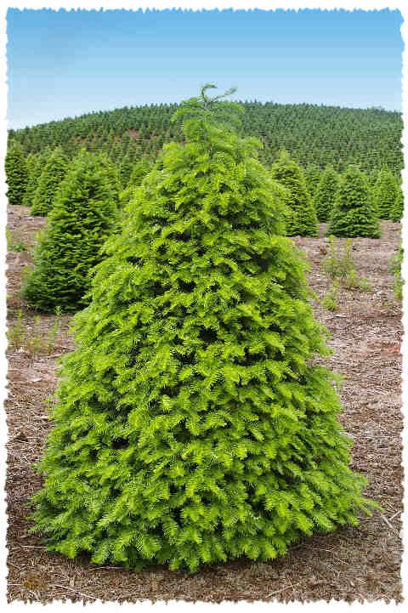
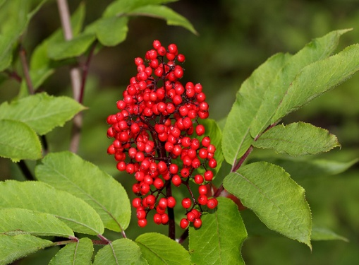
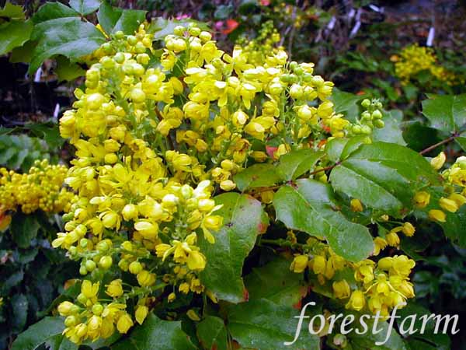
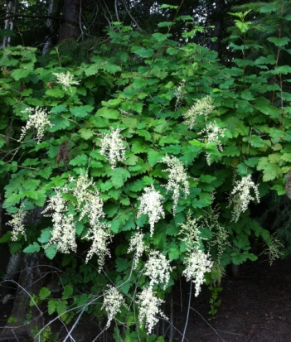
Lowland
Common Trees
Common Shrubs
Douglas-fir
Grand fir
Coast red elderberry
Ocean spray
Oregon grape

Slide 6
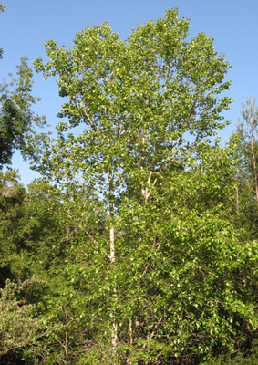
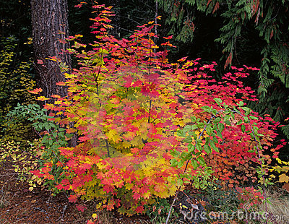
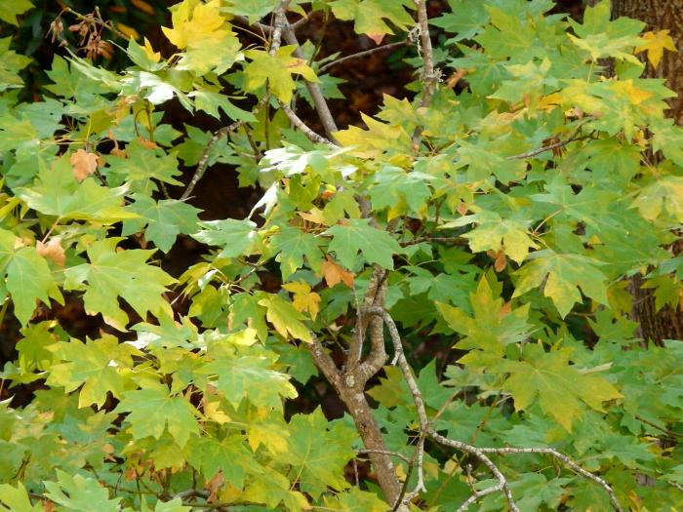
Temperate forest
Moderate temperatures:
Common Trees
Common shrubs
Black Cottonwood
Vine maple
Big leaf maple
huckleberry
salmonberry

Slide 7
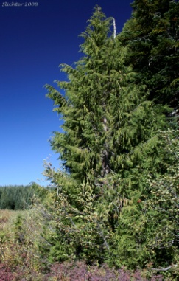
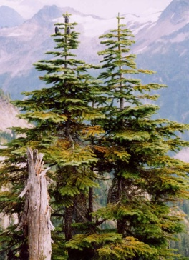
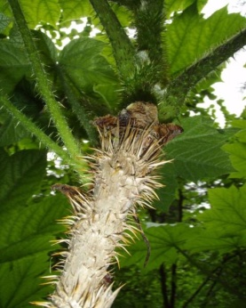
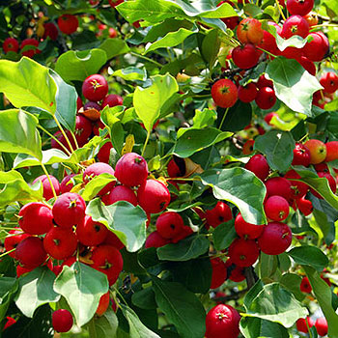
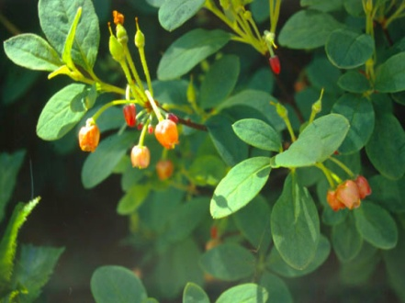
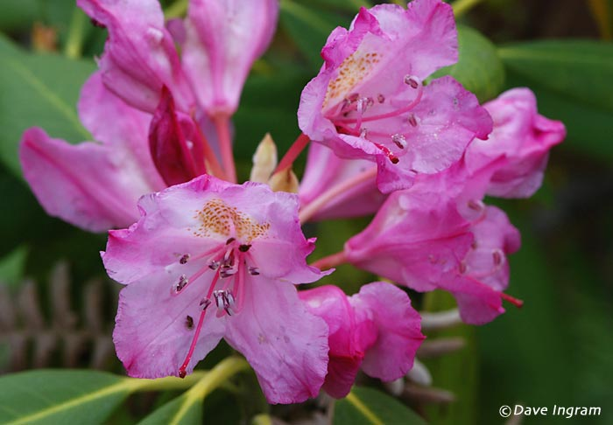
Montane forest
Montane forest begins at about 1,500­–2,000 feet and­­ transitions into subalpine forests at about 4,000 feet.
Common Trees
Alaska yellow-cedar
Silver fir
Common shrubs
Fool’s huckleberry
Devil’s club
Pacific rhododendron
Bearberry

Slide 8
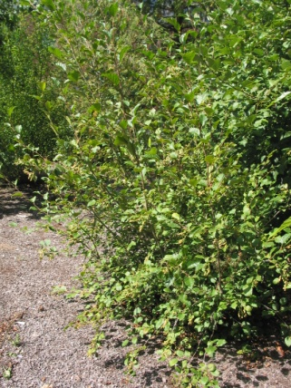
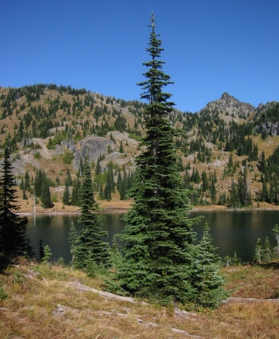
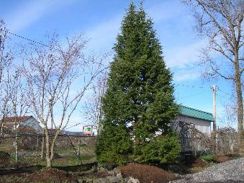
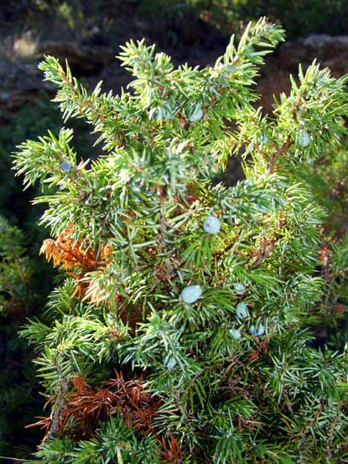
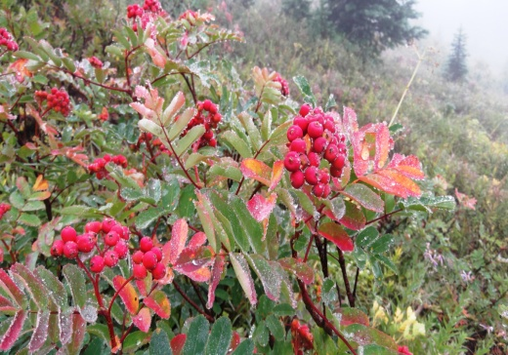
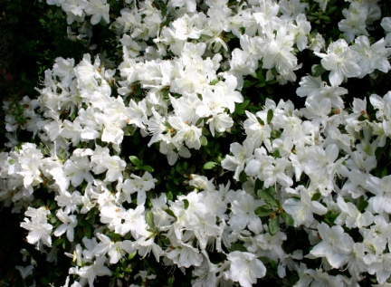
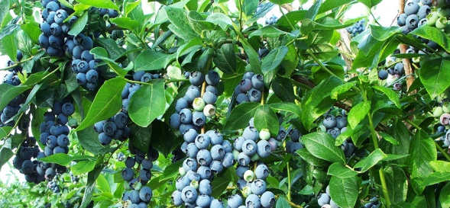
SUBALPINE FOREST
Fire also wields a powerful brush in the subalpine zone. The Olympics are known for rain, but in the summer, very little falls.
Common Tree Species
Common shrubs
Mountain hemlock
Sitka alder
Subalpine fir
Blueberries
Common juniper
Sitka mountain-ash
White rhododendron

Slide 9
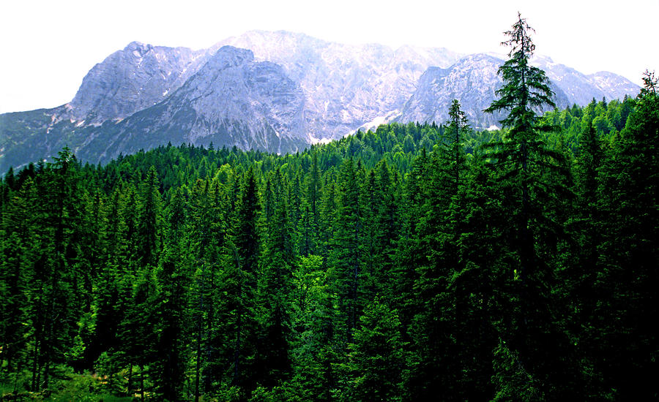
Alpine forest
Characteristics:
Hugging the ground to avoid the drying winds
Having small waxy or hairy leaves to conserve moisture
Having bulbs or tap roots to store energy over winter and fuel growth each spring
Being able to grow at cold temperatures and even while snow-covered
Forming their buds the year before

Slide 10
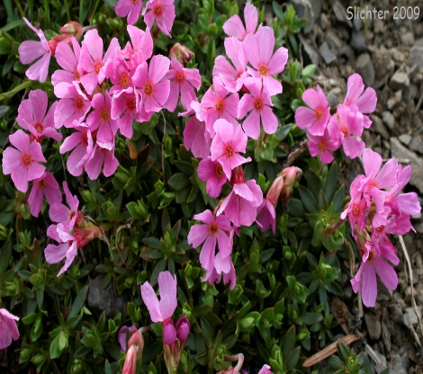
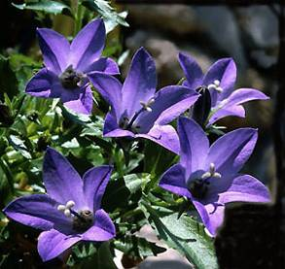
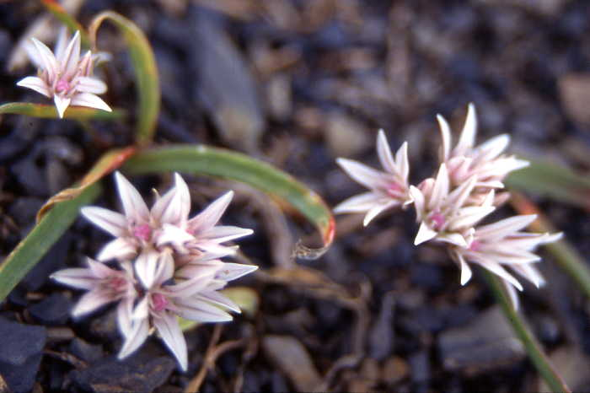
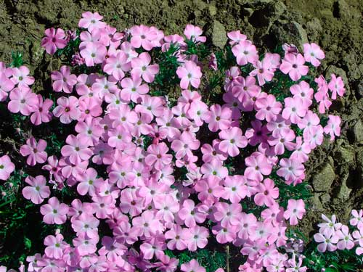
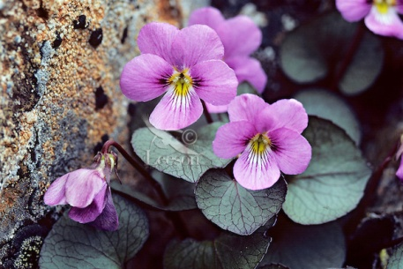
Alpine forest
Alpine Wildflowers
Smooth douglasia
Scalloped onion
Spreading phlox
Piper’s bellflower
Flett’s violet

Slide 11
Bibliography
http://www.nps.gov/olym/naturescience/plants.htm

